Slide 1
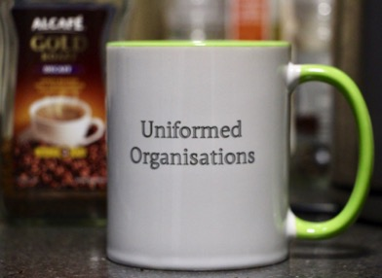
Sedgley’s Uniformed Organisations PAST AND PRESENT
Sedgley Friendship Group
REMINISCENCE CAFÉ
Friday 8th November 2019
All Saints’ Church, 11am

Slide 2
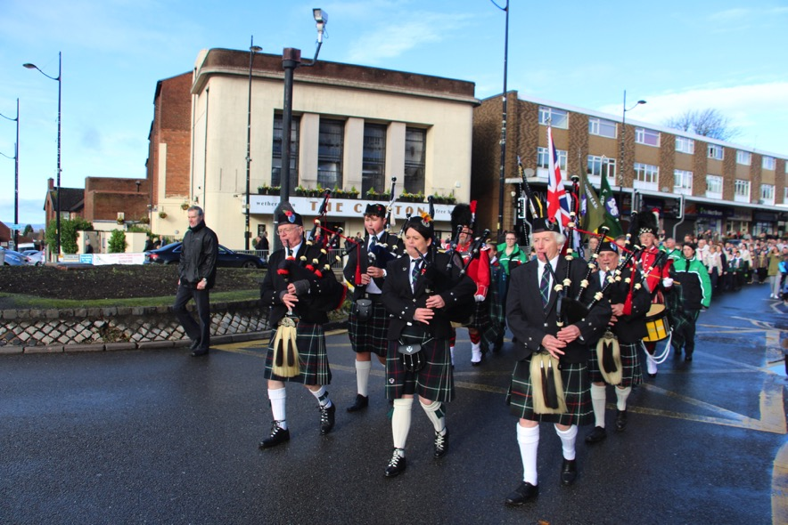
11 November 2018 - Sedgley Royal British Legion Remembrance Sunday
Parade of Uniformed Organisations from the Ex-Servicemen’s Club, through the Bull Ring Sedgley, to All Saints’ Church for the annual Service of Remembrance.

Slide 3
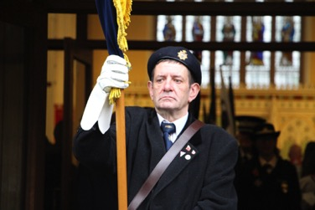
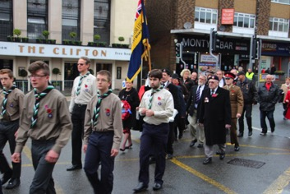
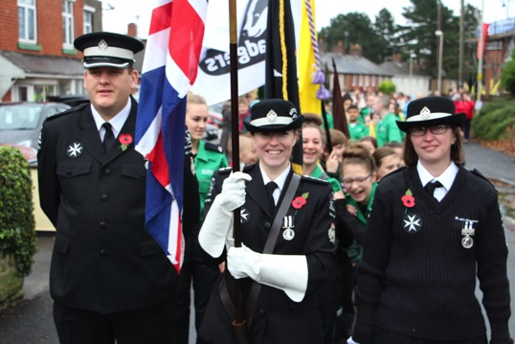
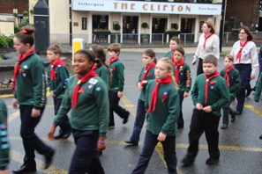
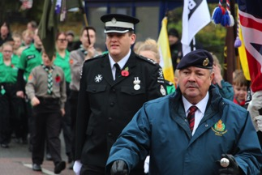
The Parade includes local uniformed organisations and starts at the
Ex- Serviceman’s in The Walk; proceeds down High Street to the Bull Ring, up Dudley Street and then wheels right into Vicar Street, finishing at All Saints’ Church.
Sedgley’s Remembrance Sunday Parade 2015

Slide 4
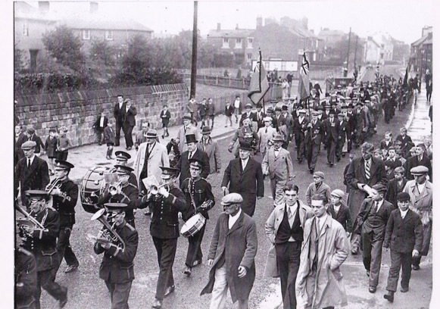
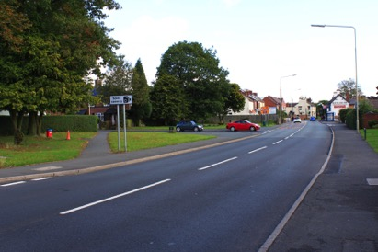
An Armistice Day parade along Bilston Street, probably in the mid 1930's (before 1945 remembrance of those who died in the First World War generally took place on 11th November itself. After the Second World War the main observance or 'festival of remembrance' was moved to the Sunday nearest 11th November, in honour of the fallen of all wars and conflicts).

Slide 5
ORGANISATIONS COVERED
Fire Service
Police Service
Territorial Army
Scouts
Guides
Salvation Army
St John Ambulance
Army Cadets
Royal Air Force Cadets
Home Guard
Post Office
Temperance movement

Slide 6
THE FIRE SERVICE

Slide 7
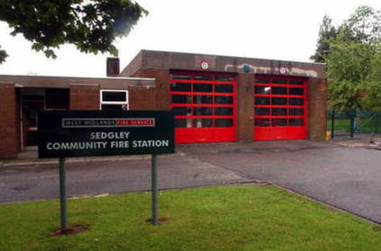
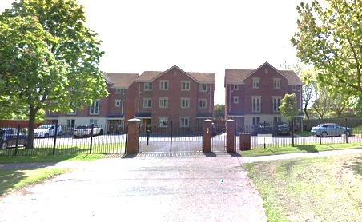
Sedgley had its own Fire Station in Tipton Road up till its closure in 2007 - despite a public campaign to save it, including a 12,000-name petition. The site is now occupied by 3-storey private houses.
During the 1950s and 1960s, Sedgley's Fire Station was at The Limes in Catholic Lane. Firemen were then part time and would be summoned from their beds by a wartime air raid siren.

Slide 8
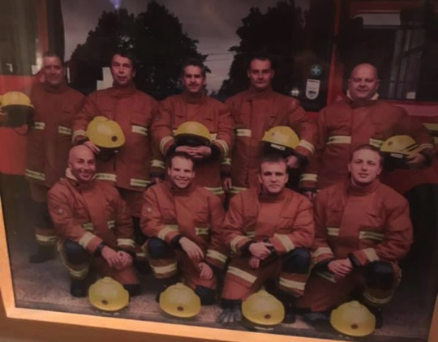
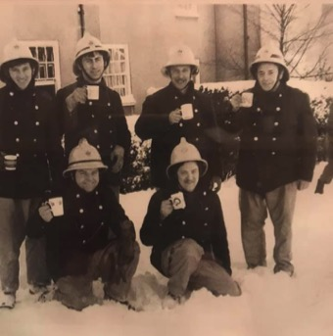
1985 – Beacon Rise
C2001-2002 taken at the station
Retained Firefighters at the former Sedgley Fire Station in Tipton Road. Ian Hale (top right 2001/2 shot) finished when the Sedgley station closed in 2007 – when he left he was Watch Commander. Firefighters were summoned by pagers although there was a siren. The photo on the right was taken after an actual callout at Beacon Rise. The numbers at the station varied from 9 to 14. Two engines were kept at the station, one was operational and one was kept in reserve.

Slide 9
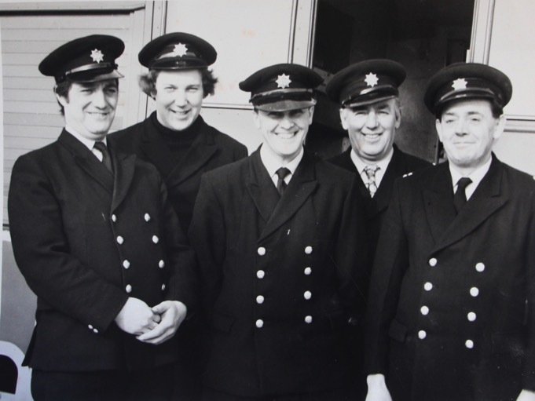
Sedgley's retained fire-fighters in 1982. They were based in Tipton Road. Mike Gregory, Colin Davies, Pete Russell, Eric Davies and Station Commander Ken Millington.

Slide 10
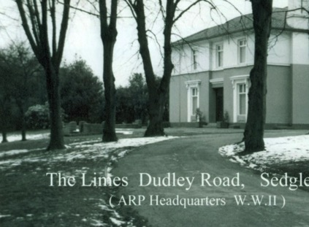
The Auxiliary Fire Service (AFS- later the National Fire Service) and Air Raid Patrol (ARP) were based at The Limes in Catholic Lane along with the rest of Civil Defence during the second world war. Fire Watchers scouted for incendiaries from the tower. There was an air raid shelter in the basement and the gardens were used to grow vegetables.
The Limes has had a wonderful history - first the home built for Eliza Tinsley, and later occupied by prominent Sedgley families, it was bought in 1931 by the Roman Catholic Diocese as a Catholic Seminary, but never used as such. In 1938 it was commandeered by the War Office. In the 1950s it was council offices.
It was used by a computer firm in the early 2000s. By 2011 it was derelict, then saved and converted to flats with a new wing added.

Slide 11
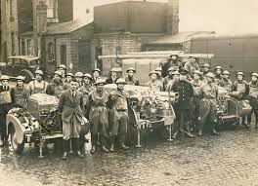
Sedgley's Auxiliary Fire Service at Jack Darby's Picture House in c1938 - their HQ was The Limes in Catholic Lane but their equipment was kept behind the cinema. They were later absorbed into the National Fire Service in 1941.

Slide 12
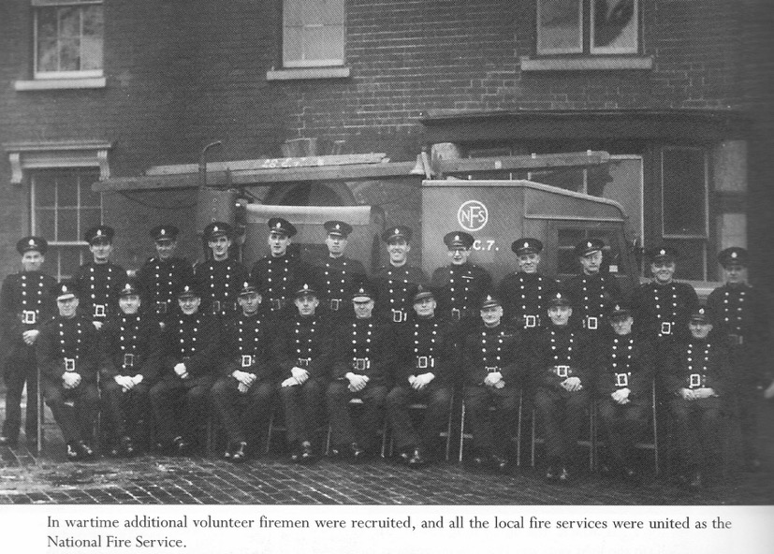
Local Auxiliary Fire Services united into a National Fire Service in 1941.

Slide 13
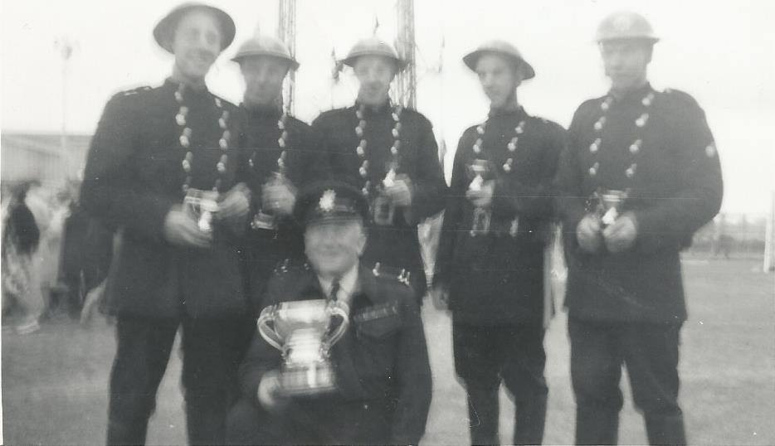
Terry Kenny:
A photo of us winning the last National AFS 5 man light portable pump drill at the GEC sports ground in 1967. L to R, Me, John Smith, Alan Taylor, Harold Ross and Bill Smith. Our Station Master was a Leading Fireman in Dudley and a former Bomb Disposal Sergeant during WW2.

Slide 14
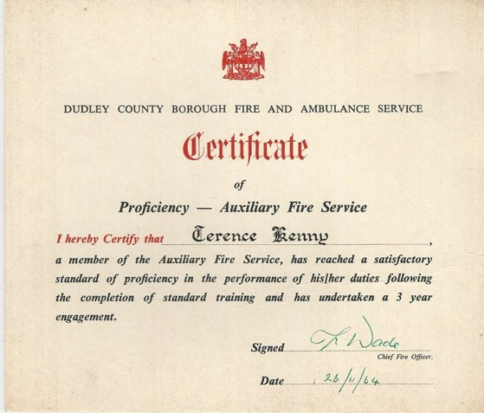
Terry Kenny:
Not Sedgley but Dudley covered the area when I joined in 1963

Slide 15
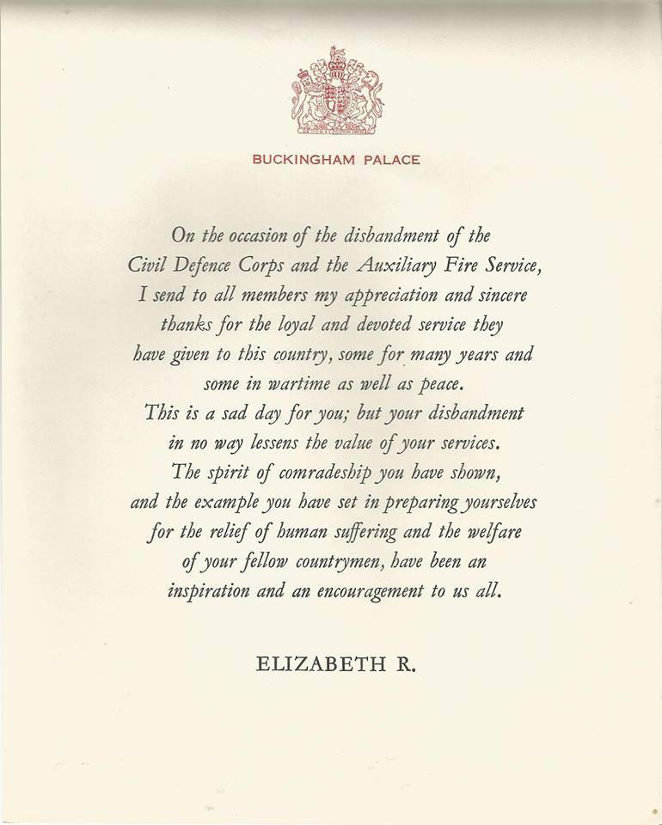
AFS closed down along with Civil Defence in March 1968.

Slide 16
THE POST OFFICE

Slide 17
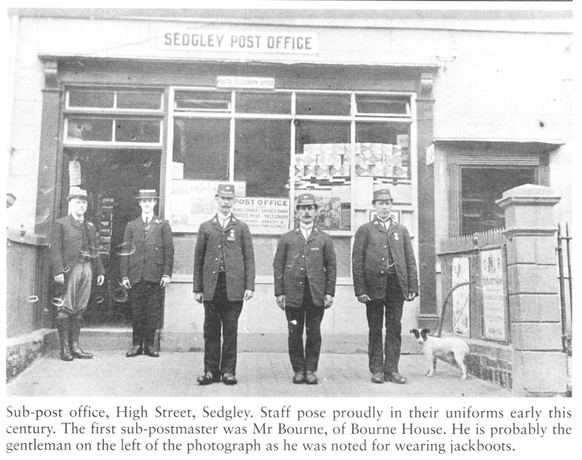
Sedgley's former uniformed postmen and postmaster Mr John W. Bourne. This photo may well date from when the post office had just moved across to the High Street (part of what is now Tasty Plaice) in 1911. Previously it had been housed in No.1 Bilston Street (later Elizabeth Cooper's and formerly part of the steam flour mill complex on the corner of Bilston Street and High Street).

Slide 18
THE POLICE SERVICE

Slide 19
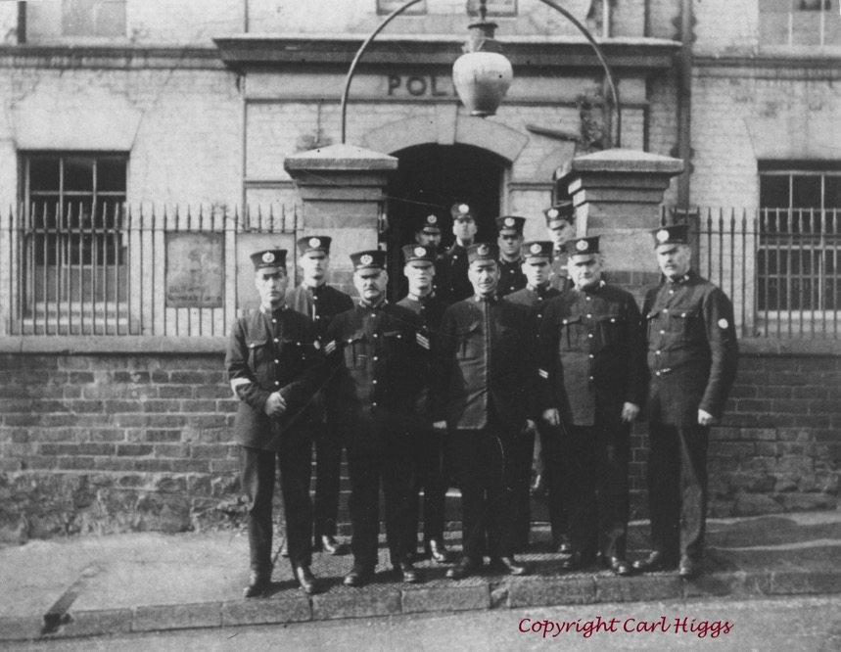
Sedgley Police 1910

Slide 20
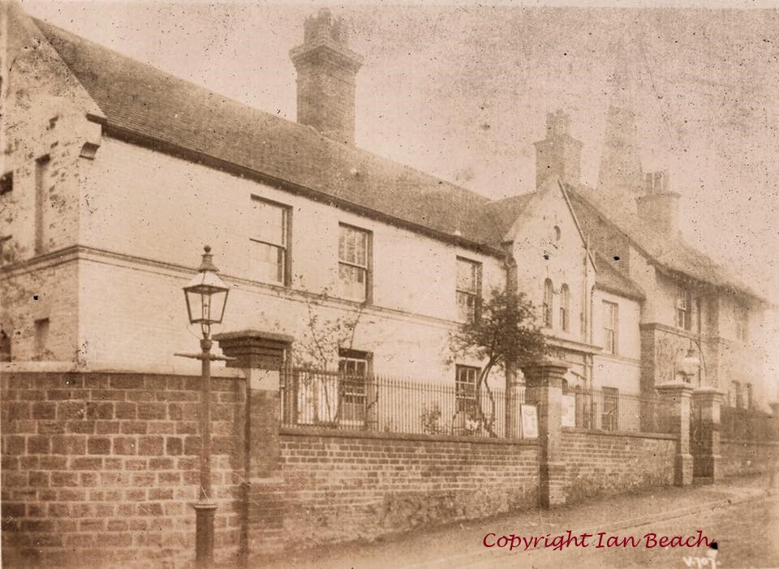
Vicar Street Police Station and Inspector's House, from a postcard of 1909

Slide 21
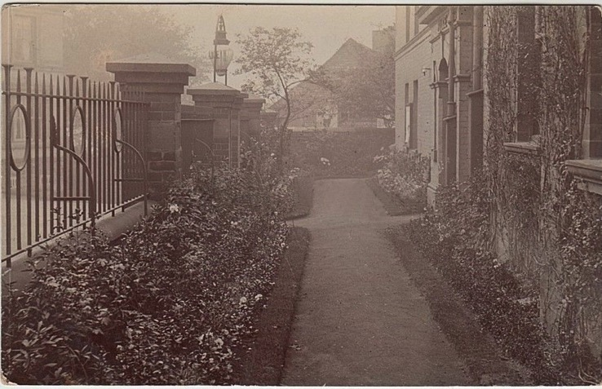
Frontage of Vicar Street Police Station in an early 20th century photo... I've now realised the gable end of the building visible beyond the wall must surely be an extremely rare view of the Bush Inn (demolished 1925) at the junction of Gospel End Street, also known as 'Bush Bank'!

Slide 22
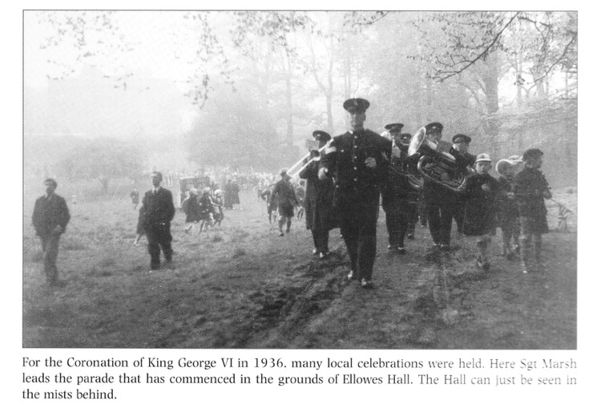
Sergeant Marsh leads the parade at the Coronation of King George VI 12th May 1937, starting at Ellowes Hall.

Slide 23
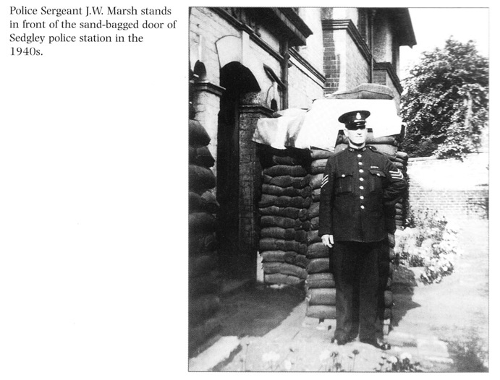
Police Sergeant Marsh in front of the sand-bag ged door of Sedgley Police Station in the 1940s.
Carl Higgs: when I had a look around the police station in November 2009, one of the officers pointed out a 2nd World War air raid siren (one of the old wind-up ones I think) sitting on top of a cupboard. I don't know if it had always been there or if it had come from The Limes originally.

Slide 24
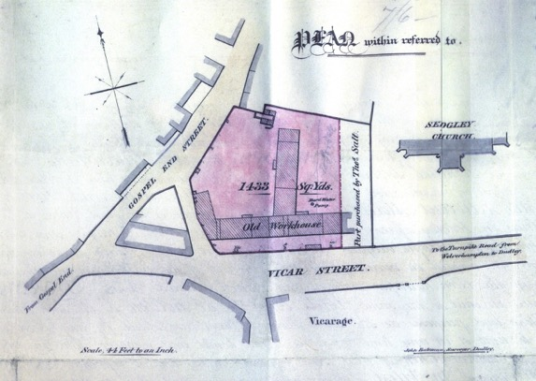
The parish workhouse was built in 1734 on land donated by William Ward, Earl of Dudley. A tablet originally from the workhouse was fixed to the door of the old Vestry Room which stood on the corner of Vicar Street and Dean Street in 1858. It bore the following inscription: “This workhouse (for the maintenance of the poor of the parish of Sedgley) was erected in the year of our Lord 1734, the ground within the walls being freely given by the Rt. Honble. William Lord Dudley and Ward, at the request of John Ward Esq and the Revd. Mr William Ward Vicar of the said Parish.” Also from minutes of the Board of Guardians for 13th May 1859:
Ordered that the Inmates of the Sedgley Workhouse be removed to the Union Workhouse on the 23rd of June next..

Slide 25
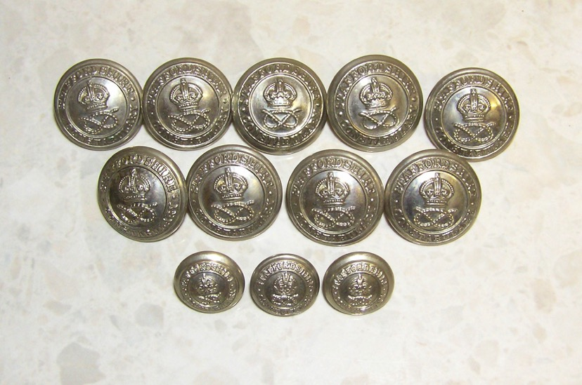
Early 20th century Staffordshire Constabulary police buttons, showing the 'King's Crown' c.1902-1936

Slide 26
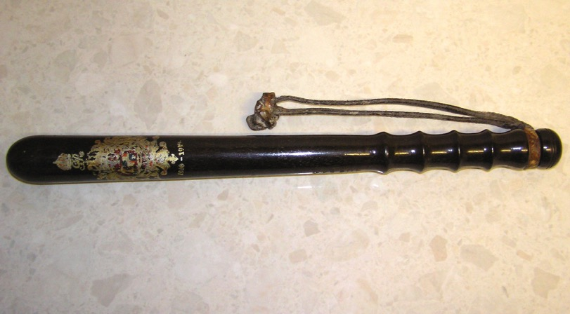
Early 20th century night stick or truncheon (1910-1936)

Slide 27
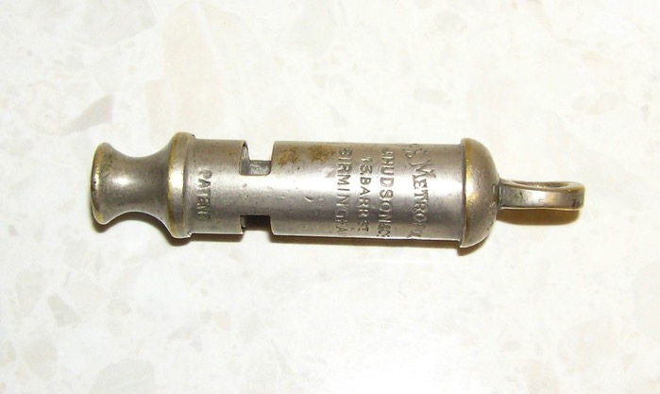
'The Metropolitan' was a standard issue early 20th century policeman's whistle

Slide 28
Sedgley Police pose outside Vicar Street Station c.1919-24 - the notice on the railings to the left is an early Royal Air Force recruitment poster, while my great grandfather Sergeant Thomas Hall (standing 2nd from left on front row) retired in August 1924, which helps date this photo.
The inspector standing next to him (front centre) is probably Arthur J. Dix, and the R.A.F. connection may be explained as follows:
From Dudley Herald 30th April 1921 Page 9 'Sedgley Notes';
THE R.I.C. – Lieut. A. Dix, son of Inspector Dix (in charge of the police in the Sedgley division) is now in Ireland, having joined the R.I.C. He has already had several narrow escapes of being ambushed but, fortunately, he is still on duty. During the great war he was a lieutenant in the Royal Air Force, and on leaving the army rejoined the Staffordshire County Constabulary, and was stationed at Sedgley till he went to Ireland.
Arthur J Dix seems to have taken over as Inspector at Sedgley early in 1920, from Charles Robinson, who had been a constable involved with the notorious Wyrley horse maimings of 1903, otherwise known as the 'Edalji case', that attracted the attention of no less a person than Sir Arthur Conan-Doyle. Though popular, Inspector Dix was only at Sedgley for about a year before being promoted to Superintendent and transferring to Wednesbury. His replacement at Sedgley was Inspector John Parsons.

Slide 29
Sedgley Police Station Remembered 1955-1966
My mother Marion Hall was the granddaughter of Police Sergeant Thomas Hall of Sedgley, but sadly never knew him as he died before she was born. Marion grew up in Beacon Rise during the dark days of the Second World War, and left school aged fourteen in 1948. She completed a shorthand typing qualification, before working briefly for Coseley U.D.C. and then in the offices of Cannon Foundry.
In 1955 Marion applied for a job as civilian clerk at Sedgley police station, then still a sub-division of Bilston, and part of Staffordshire Constabulary. She was interviewed at Bilston by Superintendent Tom Gregory, and was offered the job. Superintendent Gregory had been a policeman at Bilston since 1923 and possibly remembered her grandfather. At her interview, he seemed to recall Sergeant Hall’s party-trick was doing ‘headstands’!
Marion promptly found herself working for D.C. Arthur Golding of Sedgley C.I.D., which occupied the upstairs front office on the right of the station (facing). She was mainly required to type up C.I.D. case reports, but also typed up reports for the police officers ‘downstairs’ (still mostly men in those days).
Inspector Barsted was then in charge at Sedgley, and lived with his wife and two children in the police house adjoining the station. His office was downstairs on the far right of the building, and this had a door which connected directly to his house.

Slide 30
Anyone entering the station from the street went through to the receiving desk on the left, while the first office to the left of this contained the telephones and switchboard. Next to this was a large common room with two windows. Here officers and civilian staff would relax with tea and biscuits.
Behind the common room was a large kitchen and drying room, with built-in cupboards behind a huge fireplace, where officers could dry their clothes after walking the beat in wet weather. This was the warmest part of the station, especially in winter, as there was originally no heating in the offices apart from coal fires. But coal was often in short supply and everyone then had to sit at their desks wearing thick overcoats. Sometimes it was just too cold to type.
Meals were cooked in the kitchen by Mrs. Verona Hayward (mother of Police-inspector Martin Hayward), who was also a relative by marriage. She was referred to as ‘the matron’ and was also responsible for the cleaning and general upkeep of the station, including polishing the red quarry tiles which lined the central corridor running the length of downstairs. She certainly had her work cut out.

Slide 31
Next to C.I.D., above the front entrance was a room which had been made into a washroom, while on the far left side of upstairs was the office where Brenda Sherratt, the inspector’s secretary, worked. She also did most of the court reporting along with P.C. Dan Holden. There was also a room for Professor Webster, the pathologist. He is remembered as being very critical of frozen peas when they first appeared in shops around this time!
A real sense of camaraderie existed at Sedgley at this time, and Marion got to know many officers and their families personally. As a Sunday-school attendant at High Street Methodist Church, she often found herself looking after some of their children, and also offered to baby-sit for them. Social events were often organised from the station including the annual police ball, as well as the occasional dinner dance.
Some officers (P.C. Cyril Hickson and P.C. Morgan in particular) are remembered for their sense of humour. As the only young female clerks at the station, my mother and Brenda Sherratt often found themselves being teased, usually about some item of clothing they were wearing, though the jesting was always good-humoured. For instance, my mother often wore shoes with steel tips, for which she received a ribbing, as the sudden ‘clip clip’ of steel along the corridor would put officers on the alert – they thought it was Inspector Barsted coming!

Slide 32
There were also many amusing incidents involving officers and unsuspecting members of the public, which seem even more hilarious today. On one occasion a man ran into the station to report a traffic accident but left some time later on a stretcher, wrapped from head to foot in bandages (at Sergeant Philips’ insistence), even though he’d appeared perfectly alright when he went in.
Another time, a man who’d been arrested was brought into the station and, when questioned, told officers he’d left his front door open. The officer in charge then let him go home unaccompanied in order to lock his front door, on the understanding that he came straight back to the station – which he did!
One other time my mother recounted was when she was suspected of having contracted T.B. On this occasion all the officers, clerks, and ancillary staff were told to go and receive T.B. jabs at ‘the clinic’, which was then at Bleak House, along the Dudley Road. Inspector Barsted led everyone out of the station and had them process all the way there, just to get their injections, and then all the way back again. People must have thought it was a practice run for the Civic Sunday procession.

Slide 33
Marion remained at Sedgley police station until her marriage and a move to Wombourne in October 1966. This was also the year of total reorganisation in the force, Sedgley becoming part of West Midlands Constabulary.
In the eleven years my mother worked at Sedgley, numerous police officers came and went. Inspector Barsted was promoted to superintendent and transferred to Burton-on-Trent. Two more inspectors followed at Sedgley, before control was handed over to Dudley. Other names particularly remembered include, D.C. Norman Stirland, Sergt. Cartwright, Sergt. Baxter, Sergt. Jebb, Sergt. Pask, P.C. Dan Holden, P.C. Ken Lyon, P.C. Entwhistle, P.C. Pickering, and P.C. Alf Tenant. Many fond memories are held from those times.
In November 2009 Sedgley Police held a Christmas Open Day and myself and Christine Buckley were invited to display some of the research we'd been doing into the station's history. It was also an opportunity for me to have a look around and to see where my mum had worked 40-50 years earlier. Surprisingly, the interior layout of the station appeared to have changed relatively little compared to the description included above. There were also many stories being shared about the station reputedly being haunted (by former police personnel, some early prisoners, and also inhabitants of the station's former guise as the parish workhouse)...

Slide 34
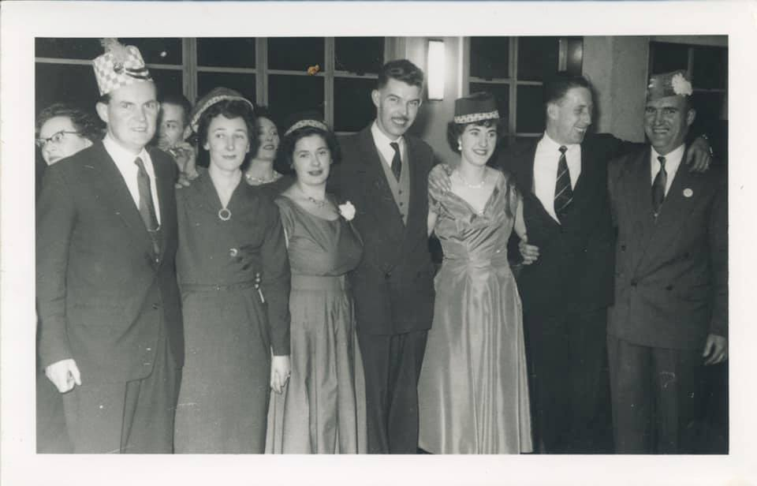
Sedgley Police Ball c1962/3. On the left of photo are Geoff & Brenda Baker.

Slide 35
Helen Dye ‪
My mother is Brenda Baker (Sherratt)
‪She started working for the Police in 1943, spending a short time at Coseley Police Station before moving to Sedgley where she remained until 1964.‬
‪Brenda lived at 6 Vicar Street (between the police house and the church) until she got married to Geoff Baker. - She didn’t have far to go to work!‬
‪She says that during the war, if there was an air raid, her family used to go down into the cellar at the police station to shelter.‬

Slide 36
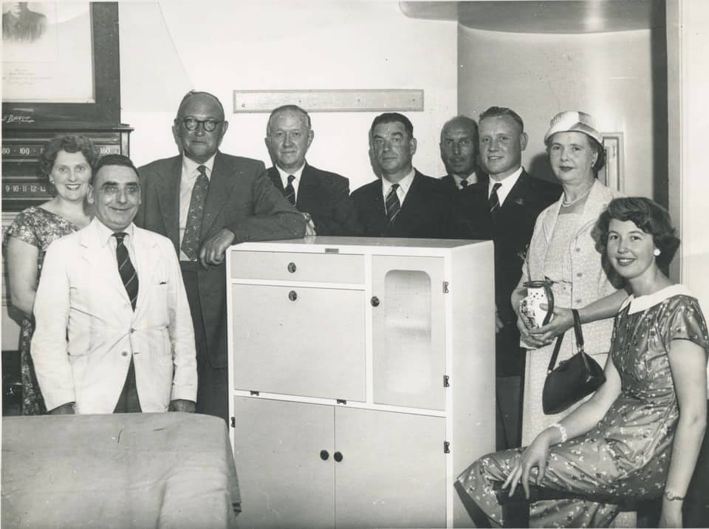
Retirement presentation for Inspector Bill Felton (with arm on the cupboard). Far right is Mrs Felton and their daughter Alison.

Slide 37
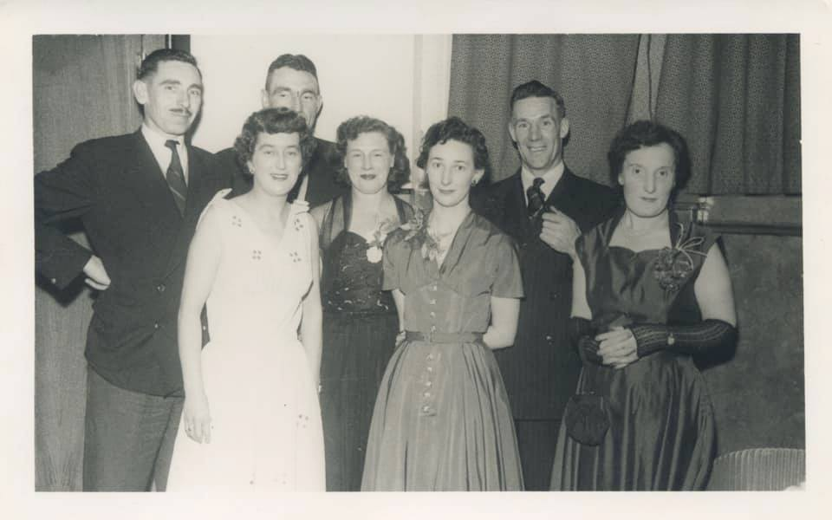
Sedgley Police Ball c1960-62.
PC Willets is on the left hand side, Brenda Sherratt in the middle at the front and next to her is PC Pearce.

Slide 38
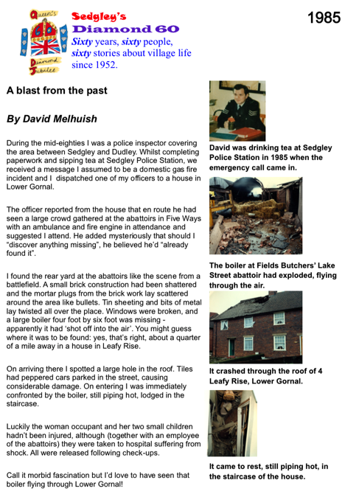

Slide 39
TERRITORIAL ARMY

Slide 40
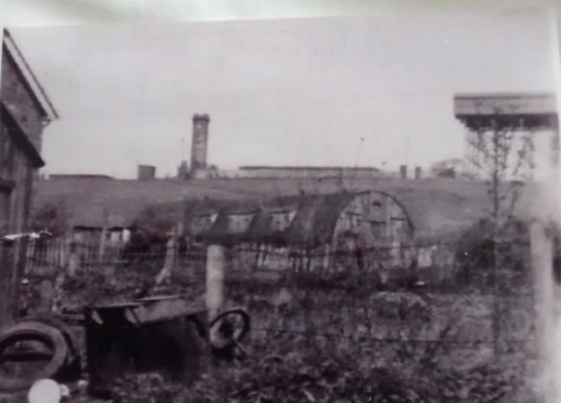
Tina White:
This photo which shows Sedgley Beacon in the background has been given to me by my uncle who lived very close to here when he was growing up. It shows a Nissen hut that was there in the 50s .
My Dad remembers playing football in there when he was a boy.

Slide 41
John Morgan: ‪
When i was a kid, we used to build trolleys and race down the footpath from the tip alongside end of North springfield and end up in Springfield Avenue, one time we removed the front axles from all but one trolley and linked them all together like a train and hared off down the track, when we got to Springfield Avenue the last trolley was missing,we went back and poor old john Edmead was in the garden,where that old wheelbarrow is (could even be the remains of his chariot) the train 'whiplashed' and threw him through the garden fence,great memories.‬

Slide 42
SALVATION ARMY

Slide 43
Margaret Hollis:
‪Sedgley Salvation Army started in Sedgley on April 12th 1926, meeting in hired rooms until 31st May 1930, when they moved into their own hall in Ettymore Road, Sedgley.
Memorable people: Major Rose Kennedy who was commanding officer for 33 years (from 1955); and her Home League Secretary Mrs. Harrison.
Hall in Ettymore Road was closed in July 2005. Meetings were then held in Tipton Street Methodist church hall (later to be St. John ambulance hall) until 2017.
Now meet in All Saints’ Church Hall every Monday afternoon. Once a month we run a dementia friendly singing group which is very popular in the community.‬

Slide 44
ST JOHN AMBUL ANCE

Slide 45
Carol Littler ‪
St John Ambulance has been in Sedgley for around 75 years I believe. Before I was unit manager we had Sarah Liggins, and before that Margaret Coomby was the Superintendent. ‬
‪We used to meet on Thursdays in what was Tipton St Methodist Church hall - before St John Ambulance purchased it. We continued to meet every Thursday with our youth sections, only closing for 2 weeks in the summer and Christmas, our youth volunteers are Badgers aged 7-10 (previously 5-10) who meet from 6.30 -8 and Cadets aged 11-18 also meet at 6.30 -8.00, then our Adult volunteers from 18 upwards meet 8.15 - 10.00 to practise our first aid skills.‬
‪We left our Tipton St building in 2017, which was subsequently sold and we now meet in Upper Gornal Methodist Church, still on Thursdays at the same times.‬
‪We provide first aid cover at local events when requested, run community first aid courses and our volunteers and friends have recently fundraised to purchase 2 Community AEDs, one at the church where we meet, the other is to be installed in Woodsetton. We are a charity and our vision is, that everyone who needs it should receive first aid from those around them. No one should suffer for the lack of trained first aiders. ‬
‪We would welcome new volunteers, from Badgers, Adults, and Youth leaders to fund raisers.‬

Slide 46
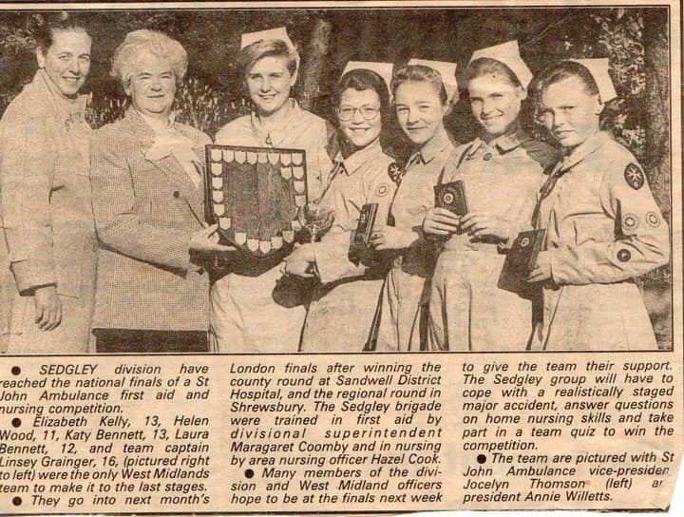
Linzi Reeves:
Sedgley St. John Cadets 1990 First Midlands team to qualify to national finals of St John Ambulance First Aid and Nursing Competition in London for years! we came 9th

Slide 47
SCOUTS

Slide 48
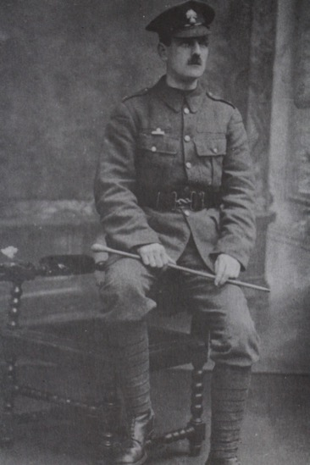
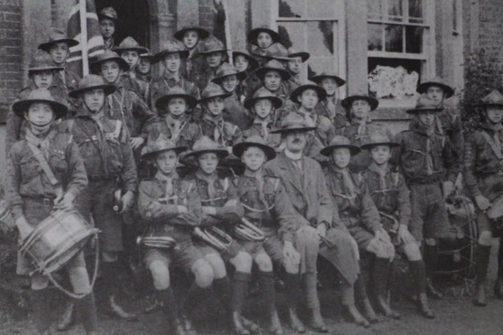
The early days of 1st Sedgley Scouts, who were founded in 1910 - shortly after Lord Baden Powell's book 'Scouting for Boys' was written in 1908. The commander was Scoutmaster Fletcher - forerunner of the Group Scoutmaster. He's seen here in his army uniform during World War One. He is also pictured with the Senior Section of the scouts in 1915.

Slide 49
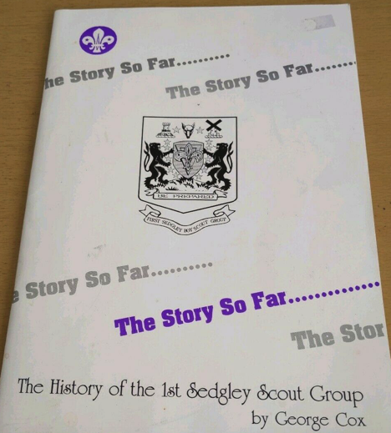
George Cox’s History of 1st Sedgley Scout Group

Slide 50
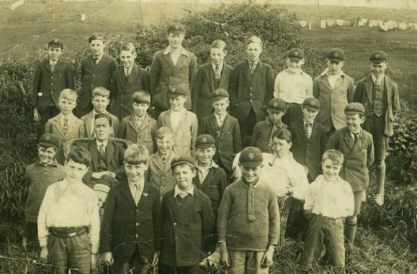
Early days of Sedgley scouting - a 'Sedgley Queen Victoria' scout troop at camp in Staithes, Yorkshire in 1928. Mr McCleod is the headmaster.

Slide 51
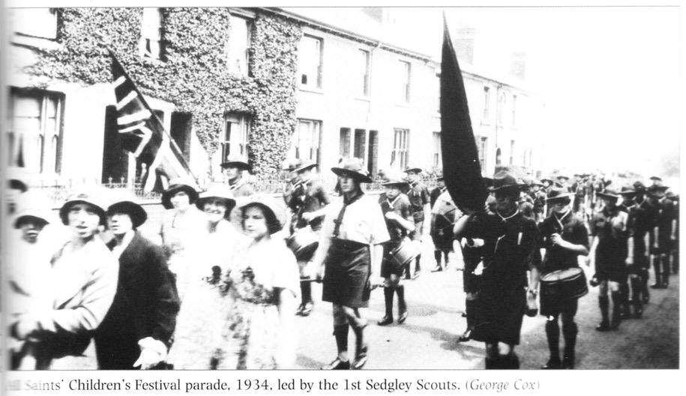
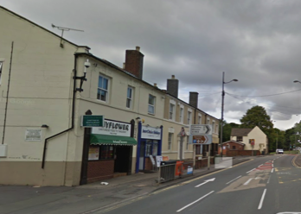
All Saints’ Children’s Festival Parade 1934 led down High Street by 1st Sedgley Scouts.

Slide 52
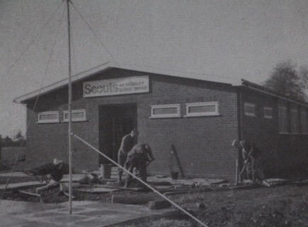
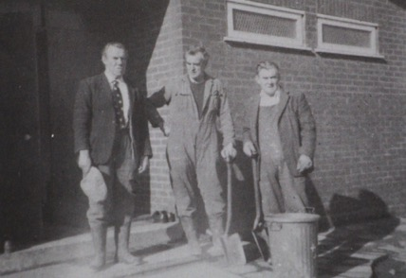
Here are photos of the building of 1st Sedgley Scout Hut in the 1970s. It was built from scratch on Sunday mornings over a four-year period 1974-77 by dedicated volunteers: The Sunday Morning Working Club included Frank Turner, Wilf Beech, Alan Turner and Lawson Turner. Up till then the scouts had met in a number of local venues including Queen Victoria School Hall, the old All Saints' Parish hall and Ruiton Windmill (1965). Later, in 1985, an extension was built to act as a group equipment store.

Slide 53
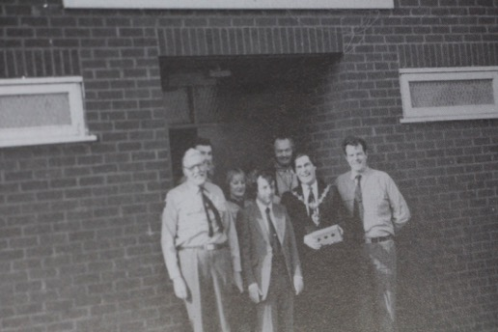
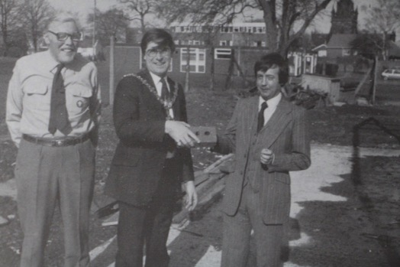
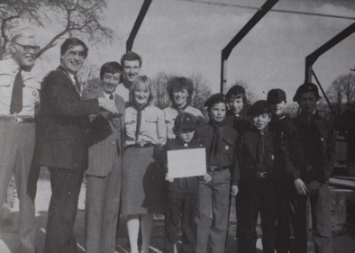
Here are some photos of George Cox with the then Mayor of Dudley Councillor David Caunt launching a campaign called 'Be a Brick and Buy a Brick' to raise money for a group scouting stores attached to the original building. The opening of 1st Sedgley Scout HQ was on Saturday 5th November 1977 - the extension was opened on 9th November 1985.

Slide 54
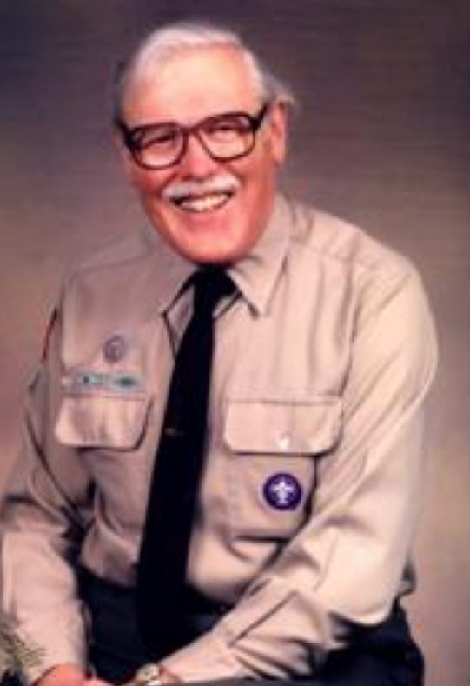
George Cox saw military service in World War II with the Royal Marines, had a long career with Mander’s in Heath Town, Wolverhampton; and was awarded his MBE by Her Majesty the Queen at Buckingham Palace in 2009 for services to the Sedgley community.

Slide 55
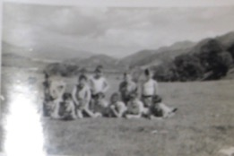
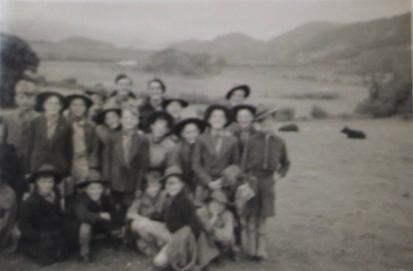
To be scanned and replaced…
First Sedgley Scouts with Mike Gregory late 1950s. Location unknown.

Slide 56
1st Sedgley Scout Leaders, 1960s.
1st Sedgley Scouts, probably 1960s. Mike Gregory is there - he's in his early 20s.

Slide 57
2nd Sedgley Lads and Dads Camp. Mike Gregory on the far left.
Chris Robinson: ‪John Mason great guy‬
Inez Dunn: ‪Randall Fones is 3rd from front at the back.‬
‪Possibly Steve Forrest next to him, but don’t know if he was a scout. ‬

Slide 58
Mike Gregory with 2nd Sedgley Scouts - a St George's Day Parade around Sedgley, c1980. Mike Gregory was Group Scout Leader. Can anyone name the location?
Sheila Semper ‪
Coming down Turls Hill Road turning into Claremont ..think you can just see BT building top of picture.‬

Slide 59
1983 - All Saints’ 2nd Sedgley Scouts and All Saints’ 1st Sedgley Guides in a Beat the Burglar campaign featured in the Express and Star. Featuring
PC Ray Dawson was the local beat bobby - he once led the Venture Scouts. Pauline Gregory's daughter Ruth is there. Also Louise and Mark Anslow.

Slide 60
Joy Smallman
‪I was stood in front of the white horse pub, as a kid, just leaning against the wall, PC Dawson said what ya think you're doing? I said nothing, he said go and do nothing somewhere else you're making the place look untidy 😂 I shuffled off & did as I was told, no fuss or answering back. Pity it's not still like that nowadays‬

Slide 61
SEDGLEY GUIDES

Slide 62
All Saints’ Girl Guides parade along High Street, c1935

Slide 63
Dormston Guides on parade in Dudley, 1966 led by Pauline Gregory.

Slide 64
Dormston Guides youth hostelling weekend, winter 1963/4.

Slide 65
Dormston Guide Company with Pauline Gregory in around 1967 at a Youth Hostel.

Slide 66
1966 or 1967: Dormston Ranger Guides and Guides at Beaudesert Outdoor Activity Centre, Staffordshire.

Slide 67
2nd Sedgley (Dormston School) Guide Company in the quadrangle of Dormston School.

Slide 68
This photo shows the 50th anniversary of 1st Sedgley (All Saints') Guide Company in 1983.
Here we see the 'new-style' uniform - and a very large company. By this time Pauline Gregory was the Guider at All Saints' and her daughter a guide; her husband Mike Gregory was Scouter at All Saints' with both sons in the Scouts.

Slide 69
1985 - Ist Sedgley Guides and 2nd Sedgley Scouts on the beach at Criccieth Gwynedd Wales.

Slide 70
All Saints' Cubs in the Church Hall, c1990.

Slide 71
ROYAL AIR FORCE AIR CADETS

Slide 72
ROYAL AIR FORCE AIR CADET GROUPS
2132 Air Training Corps
Roford Court, Off Clarence Street, Upper Gornal, Dudley, West Midlands, DY3 1UW

Slide 73
ARMY CADET FORCE

Slide 74
ARMY CADET FORCE
Ellowes Hall Detachment.

Slide 75
Army Cadet hut on The Beacon
Bob Bough ‪I was an army cadet we trained in that hut at the bottom of the beacon the man in charge was a Mr Sankey he lodged with someone name jevons,they lived in Gibbons Hill Road.‬
Dilys Chrabaszcz: ‪My bro was in the cadets, they used to meet in the Nissan hut, if memory serves me right, my dad ran it for a very short time, I don't know how that came about to be honest Martin‬

Slide 76
TERRITORIAL ARMY

Slide 77
TA base?

Slide 78
HOME GUARD

Slide 79
During the Second World War Dormston House was used as the headquarters of the local battalion of the Home Guard.

Slide 80
35th Battalion (Sedgley) South Staffs Home Guard, on church parade on Tenscore in November 1942.

Slide 81
Sedgley Home Guard relax at camp and manoeuvres in Bridgnorth.
A bell tent has been erected at the rear.

Slide 83
CIVIL DEFENCE

Slide 84
Sedgley's Civil Defence was based at The Limes, now flats, during World War 2. This is Sedgley Branch of Staffordshire Civil Defence Corps, 8th April 1945 taken in front of The Limes, Catholic Lane, Sedgley. Top row, far left: Len Fownes, whose son is Bernard Fownes. Middle row: names not known. Front row: Sid Griffiths, ?, Mrs Roden, William Cox who was a Bass in All Saints' Choir, Mr Hanson, Mr Bailey, Mr Moore, Head of Sedgley Branch of Staffordshire Civil Defence Corps, ?, Robert Lownes, ?, ?, ?.

Slide 85
OTHER UNIFORMED ORGANISATIONS

Slide 86
Sedgley Village Brass and Reed Band, c1920.

Slide 87
Sally Ann Dickens: This is a photo of the temperance movement in Sedgley, my great great grandfather Captain Joseph Cox is 4th from the left back row.

